Slide 1

WELCOME
Mobile And Application Development

Slide 2

Consuming and Accessing web services
Mobile And Application Development
Practical
Instructor: Muhammad Naeem Khan

Slide 3
What are web services?
The Internet is the worldwide connectivity of hundreds of thousands of computers of various types that belong to multiple networks. On the World Wide Web, a web service is a standardized method for propagating messages between client and server applications. A web service is a software module that is intended to carry out a specific set of functions. Web services in cloud computing can be found and invoked over the network. The web service would be able to deliver functionality to the client that invoked the web service.
A web service is a set of open protocols and standards that allow data to be exchanged between different applications or systems. Web services can be used by software programs written in a variety of programming languages and running on a variety of platforms to exchange data via computer networks such as the Internet in a similar way to inter-process communication on a single computer.

Slide 4
What are web services?
Any software, application, or cloud technology that uses standardized web protocols (HTTP or HTTPS) to connect, interoperate, and exchange data messages – commonly XML (Extensible Markup Language) – across the internet is considered a web service. Web services have the advantage of allowing programs developed in different languages to connect with one another by exchanging data over a web service between clients and servers. A client invokes a web service by submitting an XML request, which the service responds with an XML response.
Functions of Web Services
It’s possible to access it via the internet or intranet networks.
XML messaging protocol that is standardized.
Operating system or programming language independent.
Using the XML standard, it is self-describing.
A simple location approach can be used to locate it.

Slide 5
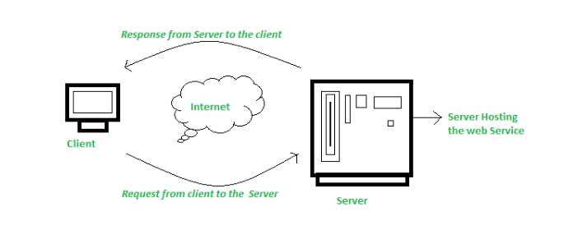
How does it works?
The diagram depicts a very simplified version of how a web service would function. The client would use requests to send a sequence of web service calls to a server that would host the actual web service.

Slide 6
STEPS
1. Using HttpURLConnection (Basic Approach)
HttpURLConnection is a built-in Java class used for making network requests.
Steps:
Add Internet Permission in AndroidManifest.xml
<uses-permission android:name="android.permission.INTERNET"/>

Slide 7
activity_main.java
import java.io.BufferedReader; import java.io.InputStreamReader; import java.net.HttpURLConnection; import java.net.URL; public class HttpHandler { public static String getDataFromWebService(String urlString) { StringBuilder result = new StringBuilder(); try { URL url = new URL(urlString); HttpURLConnection conn = (HttpURLConnection) url.openConnection(); conn.setRequestMethod("GET"); conn.setRequestProperty("Accept", "application/json"); BufferedReader reader = new BufferedReader(new InputStreamReader(conn.getInputStream())); String line; while ((line = reader.readLine()) != null) { result.append(line); } reader.close(); } catch (Exception e) { e.printStackTrace(); } return result.toString(); } } | Call the Function from MainActivity java new Thread(() -> { String response = HttpHandler.getDataFromWebService("https://jsonplaceholder.typicode.com/posts/1"); System.out.println(response); }).start();

Slide 8
Thank You

